Slide 1


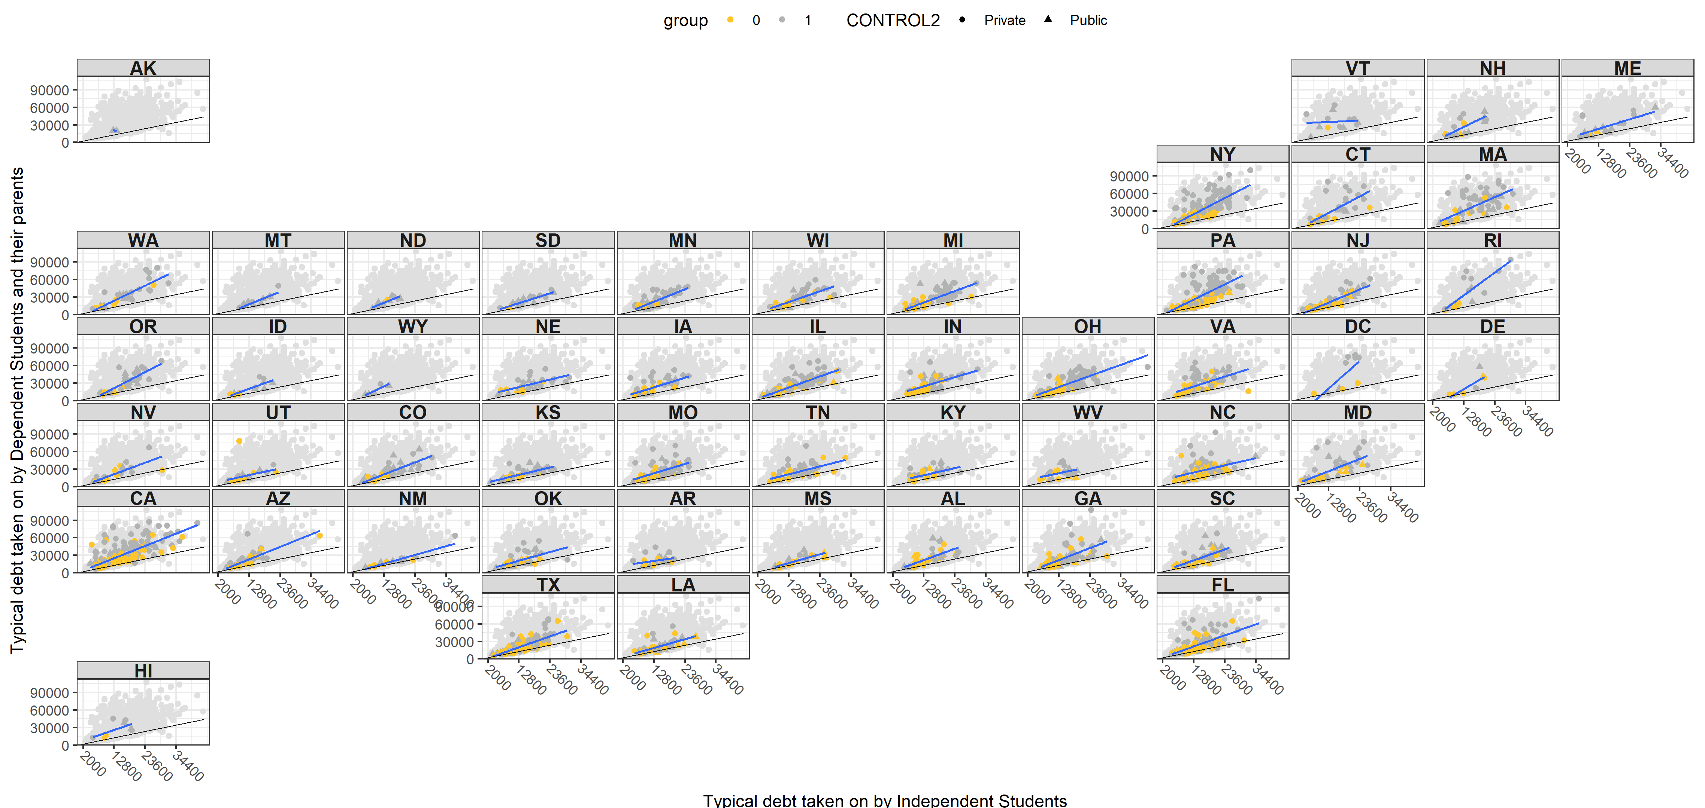
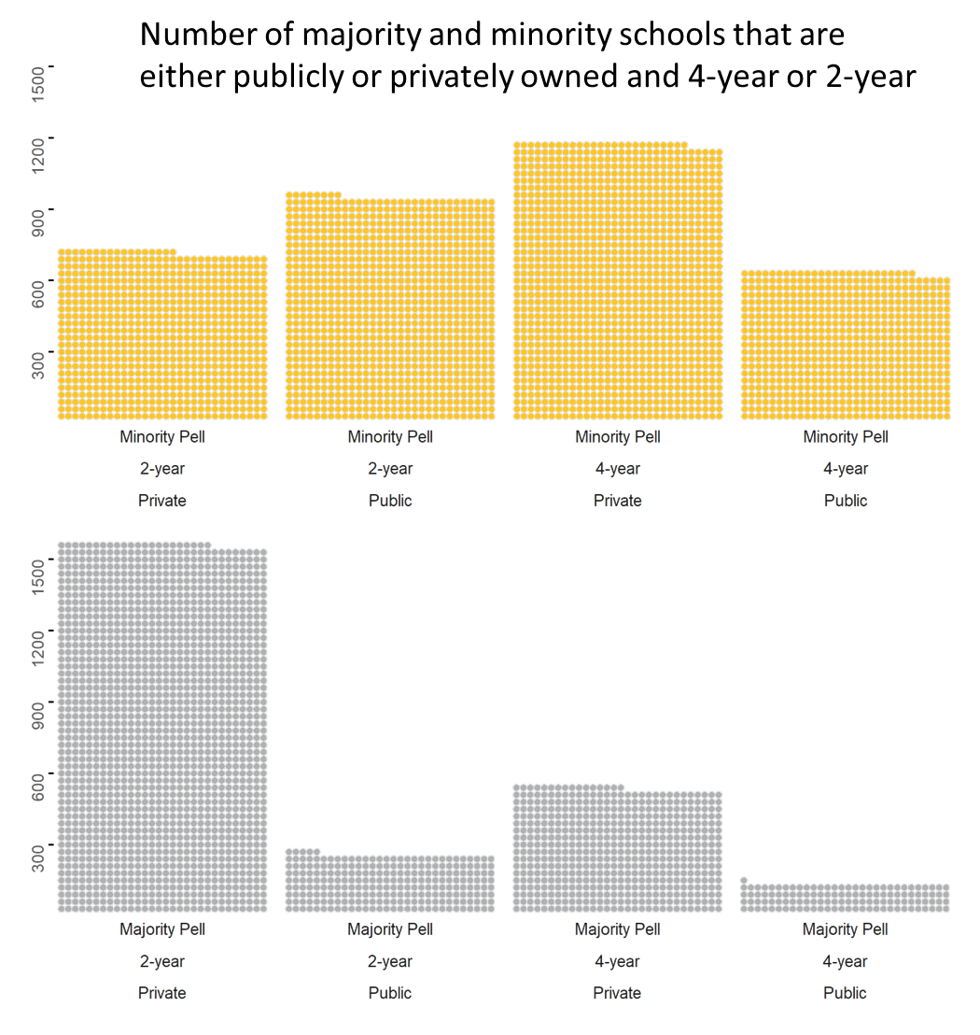
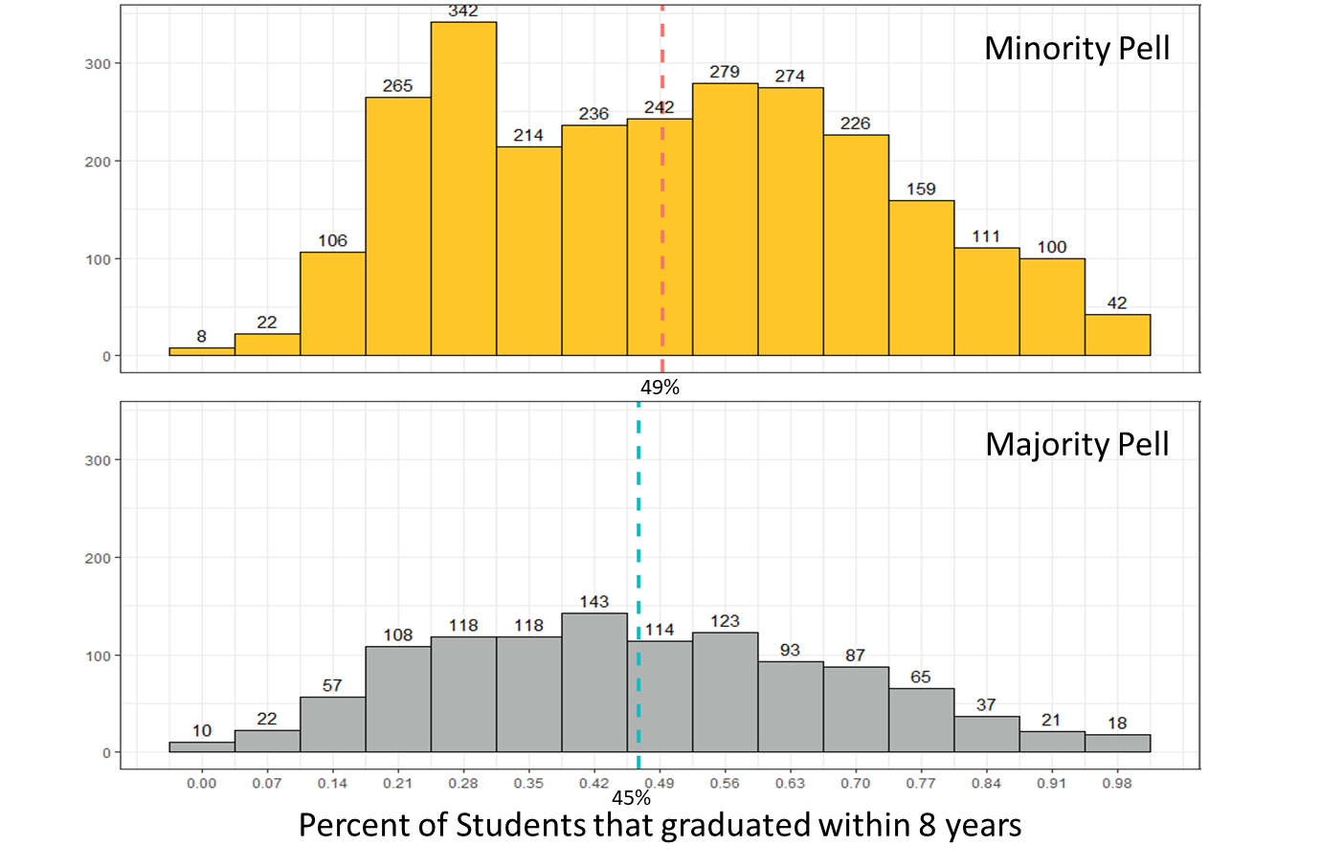
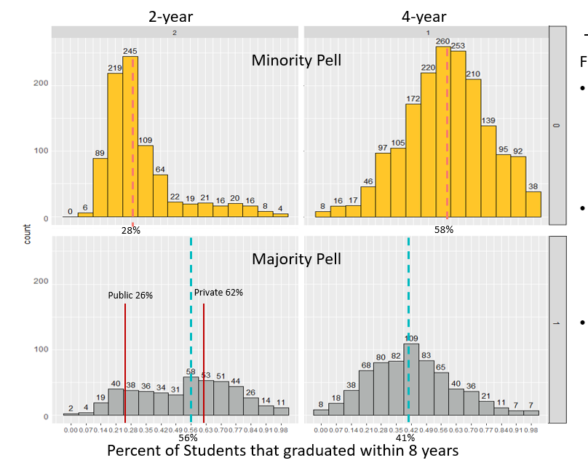
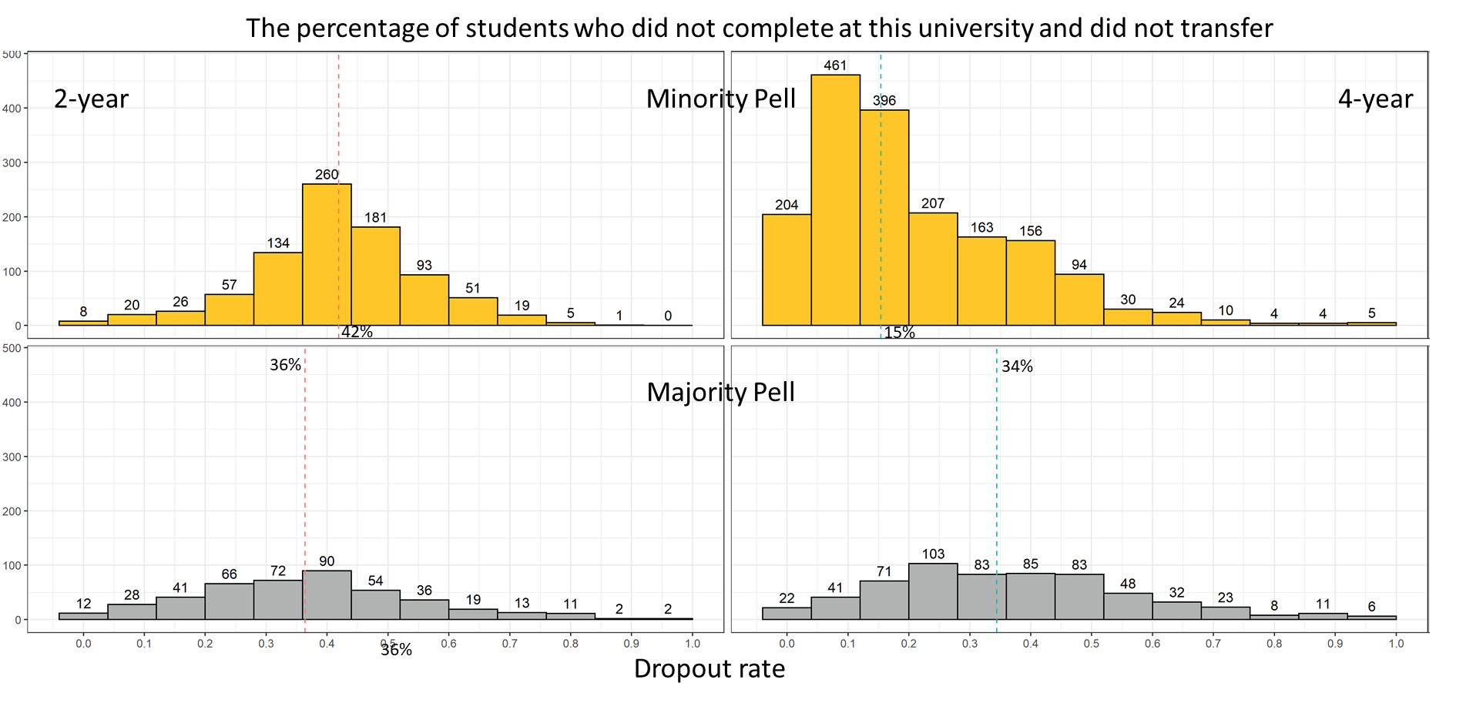
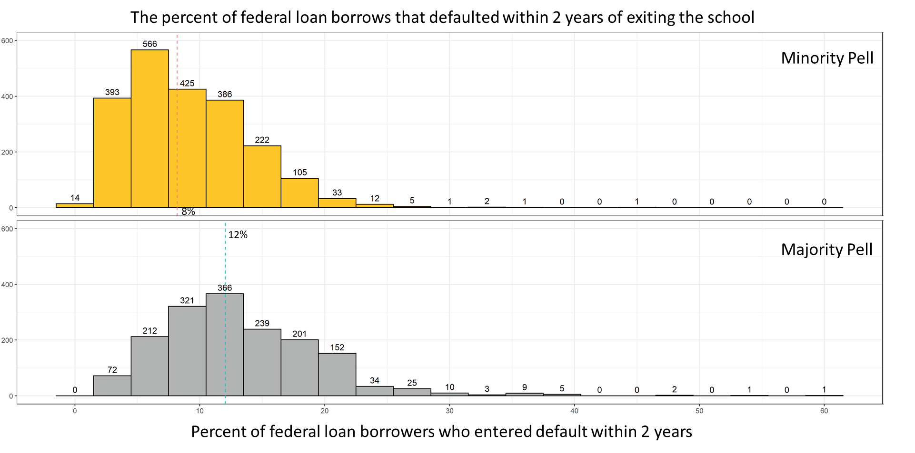


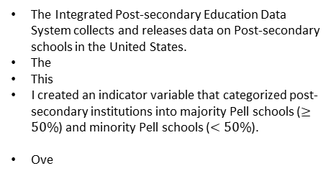
Does the Pell grant come with a price?
Nathaniel Jones
Faculty Advisors: Professor Susan Mathews Hardy and Professor J. Hathaway
Introduction
Results & Recommendations
The Integrated Post-secondary Education Data System collects and releases data on Post-secondary schools in the United States.
The
This
I created an indicator variable that categorized post-secondary institutions into majority Pell schools ($≥50\%$) and minority Pell schools ($<50\%$).
Ove
Universities and other Post-secondary institutions with a 50% or greater proportion of Pell students have a higher default rate, lower graduation rate, and a higher dropout rate than other Post-secondary institutions.
Independent students typically take on less debt during college than a dependent and their parent takes even though independent students are awarded more funds.
Methods
Coding Methods: I used tidyverse to pipe functions like mutate, filter, select, lapply, and others along side packages like stringr, pplyr, dplyr, magrittr, ggplot, ggpubr, ggh4x, geofacet, sf, sp, and tidycensus. My favorite package is magrittr because of the assignment pipe %<>%.
Data Wrangling: The CollegeScorecard dataset consist of 2,381 features, 3 id variables, and 6654 rows. I created an anonymous function that checks each column for missing values and then dropped all columns with zero entries. Observations that were missing their institutions name, proportion of Pell recipients in their student population, their longitude and latitude, and their state were dropped. This left a total of 952 variables and 6186 observations.
Checking for test validity: The normality of the examined variables was visually checked with Q-Q plots and numerically verified with a Shapiro Wilk test. Their variance was also examined with a ratio of mean deviances test.
Parametric and Nonparametric tests: The binomial test, permutation chi-square test, two-sample and k-sample permutation tests on the median, and Analysis of Variances were used.
Spatial Analysis: The census shapefiles and data from the packages tigris and tidycensus were used to create maps of the schools.

Slide 2
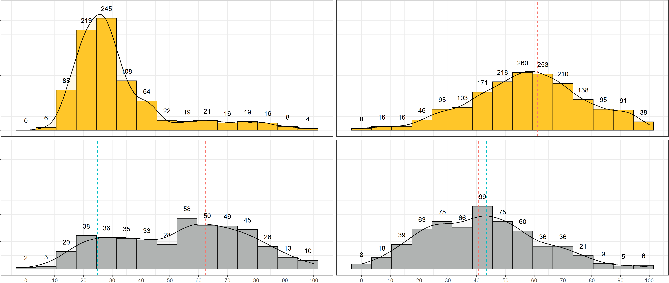
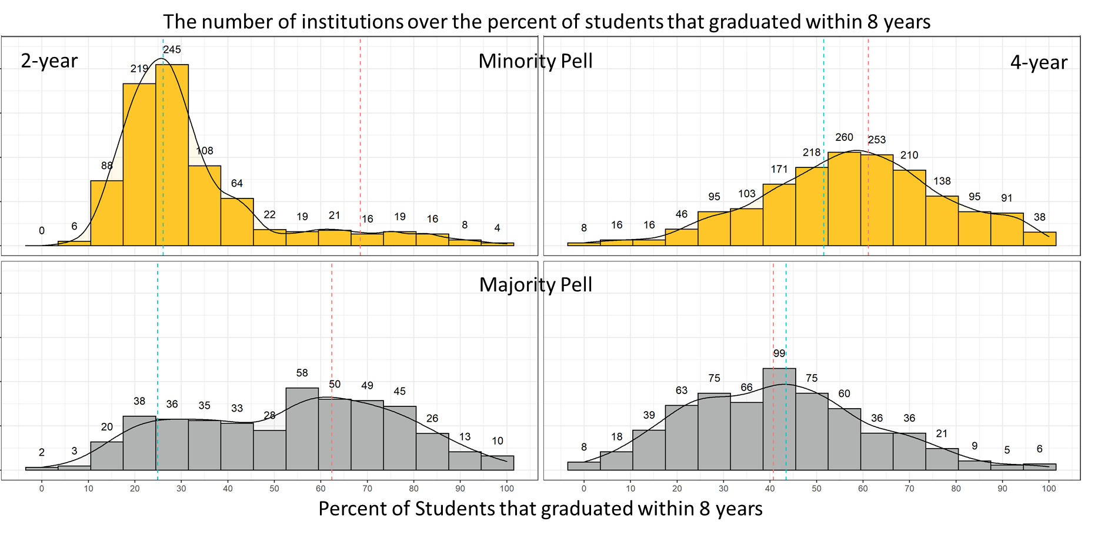
The number of institutions over the percent of students that graduated within 8 years
2-year
Minority Pell
4-year
Majority Pell
Percent of Students that graduated within 8 years

Slide 3
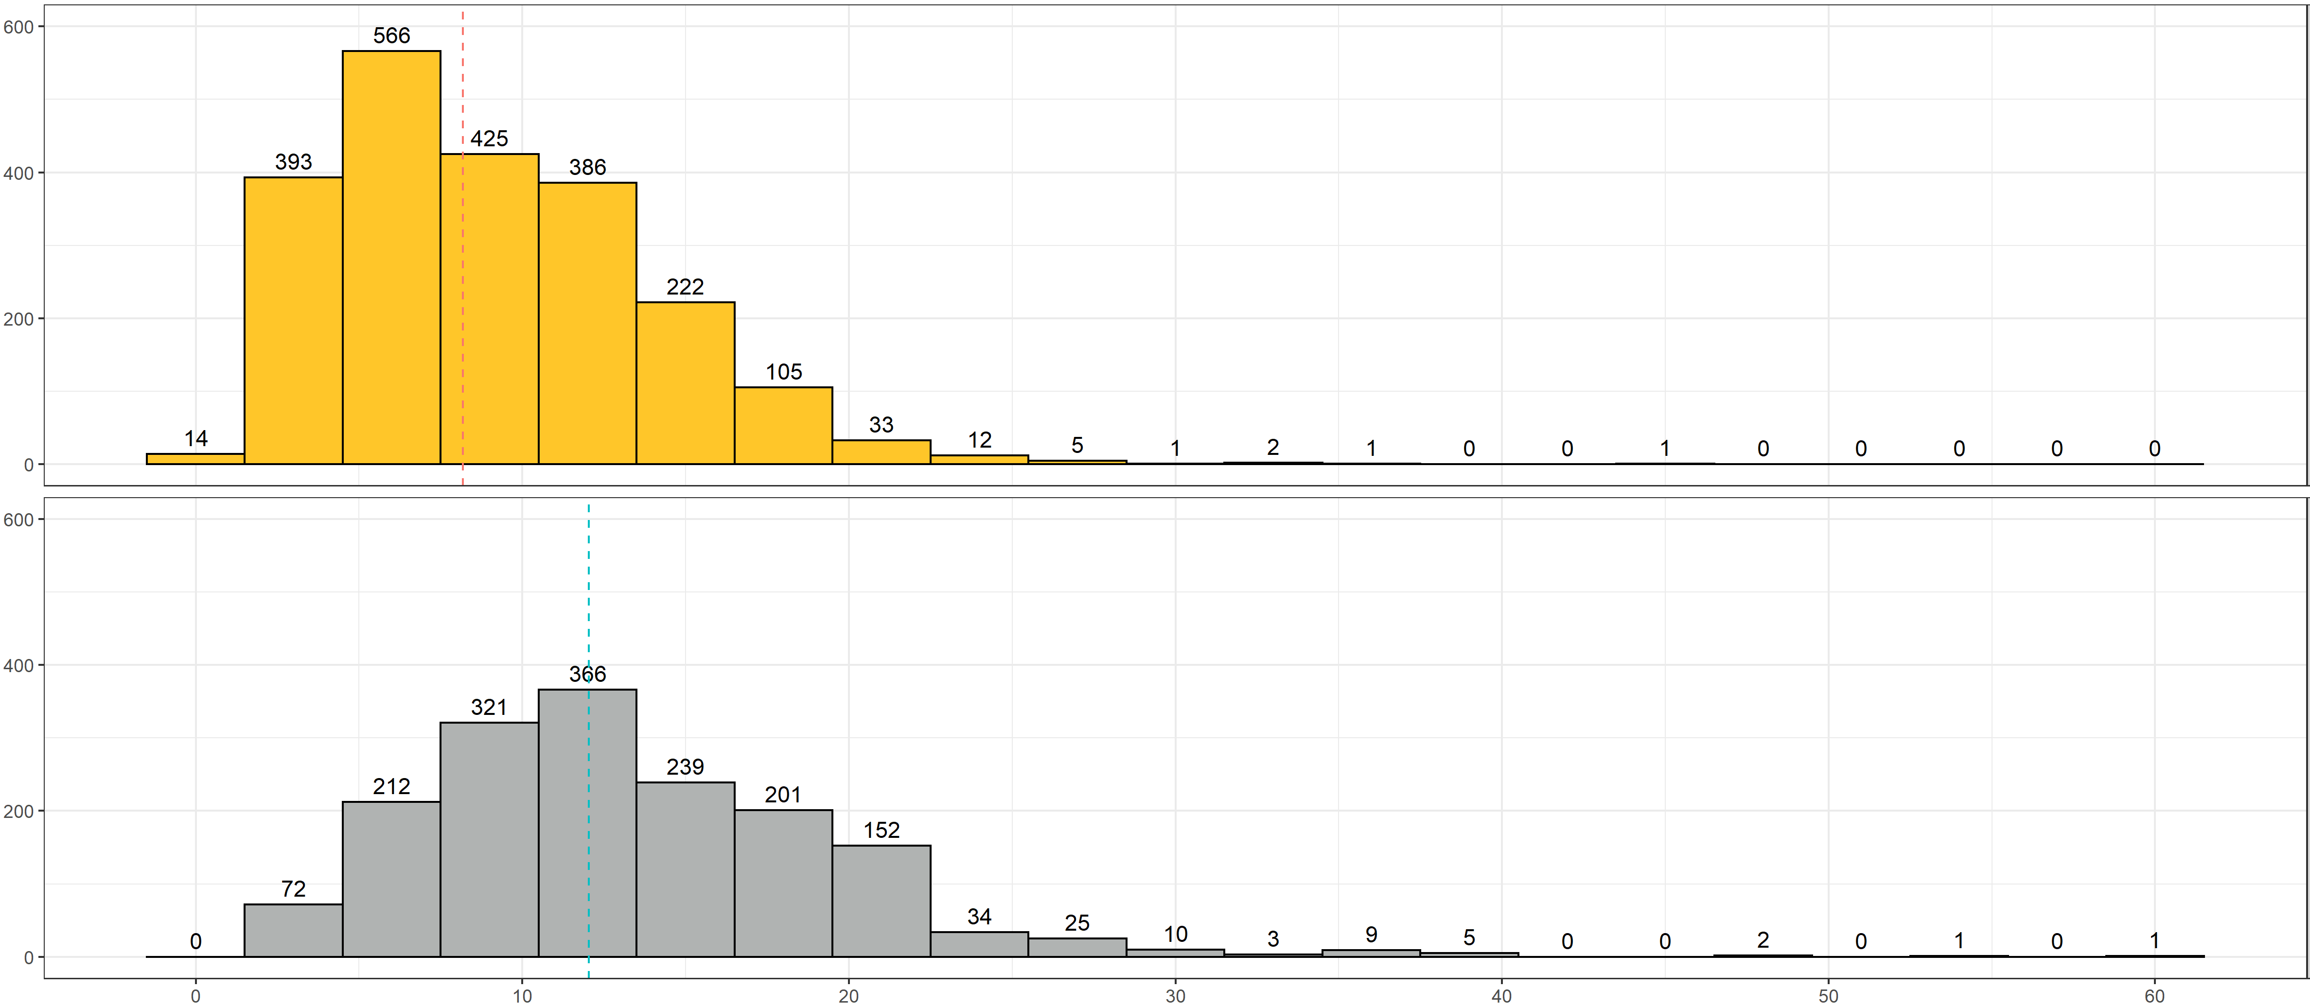
The percent of federal loan borrows that defaulted within 2 years of exiting the school
Minority Pell
8%
12%
Majority Pell
Percent of federal loan borrowers who entered default within 2 years

Slide 4
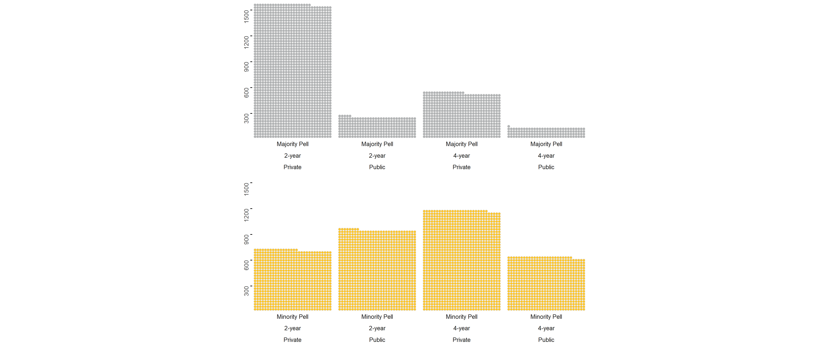
Number of majority and minority schools that are either publicly or privately owned and 4-year or 2-year

Slide 5
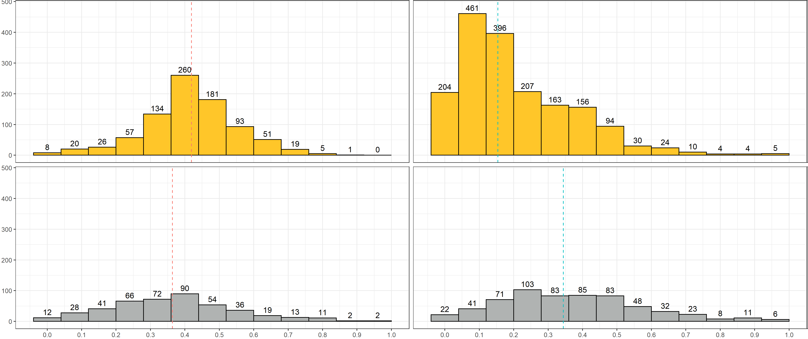
The percentage of students who did not complete at this university and did not transfer
2-year
Minority Pell
4-year
42%
15%
36%
34%
Majority Pell
36%
Dropout rate

Slide 6
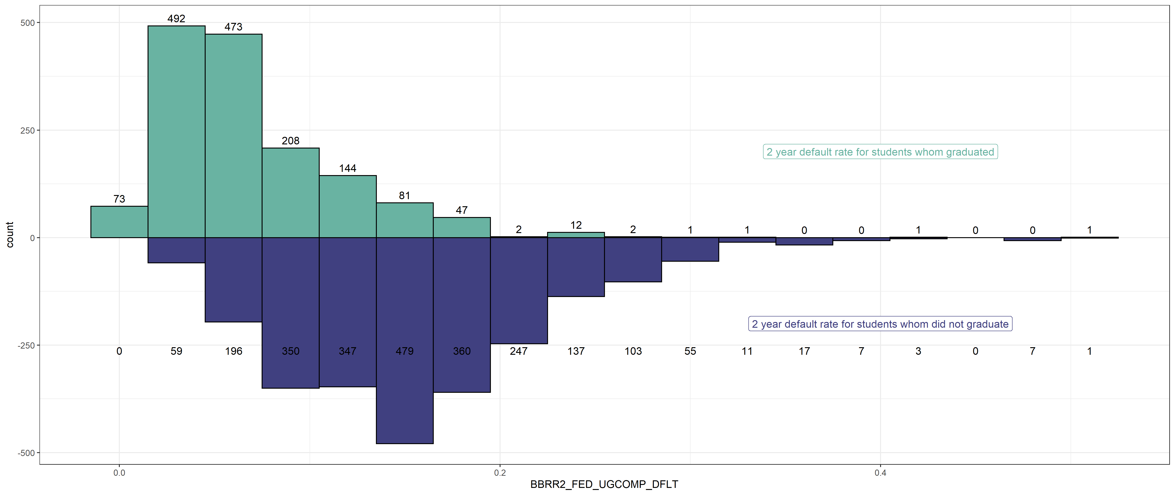

Slide 7
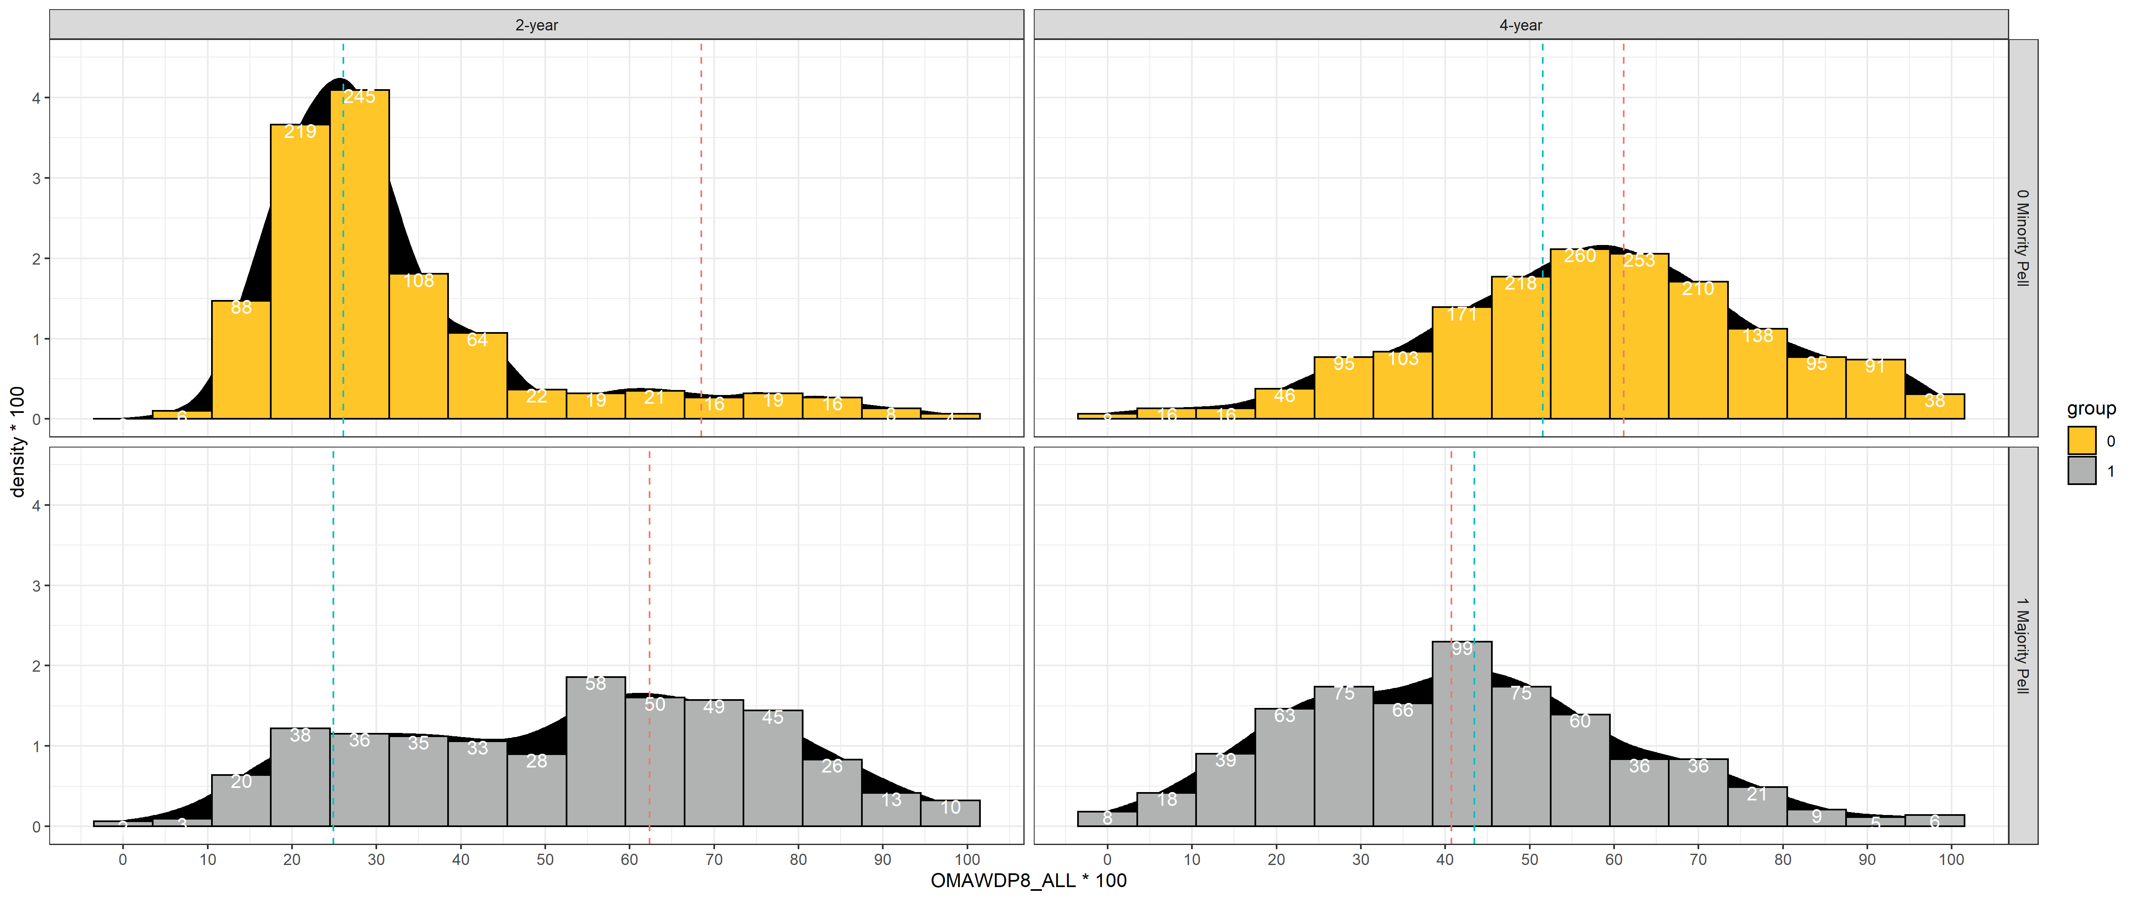




2-year
Minority Pell
4-year
Majority Pell
Percent of Students that graduated within 8 years

Slide 8
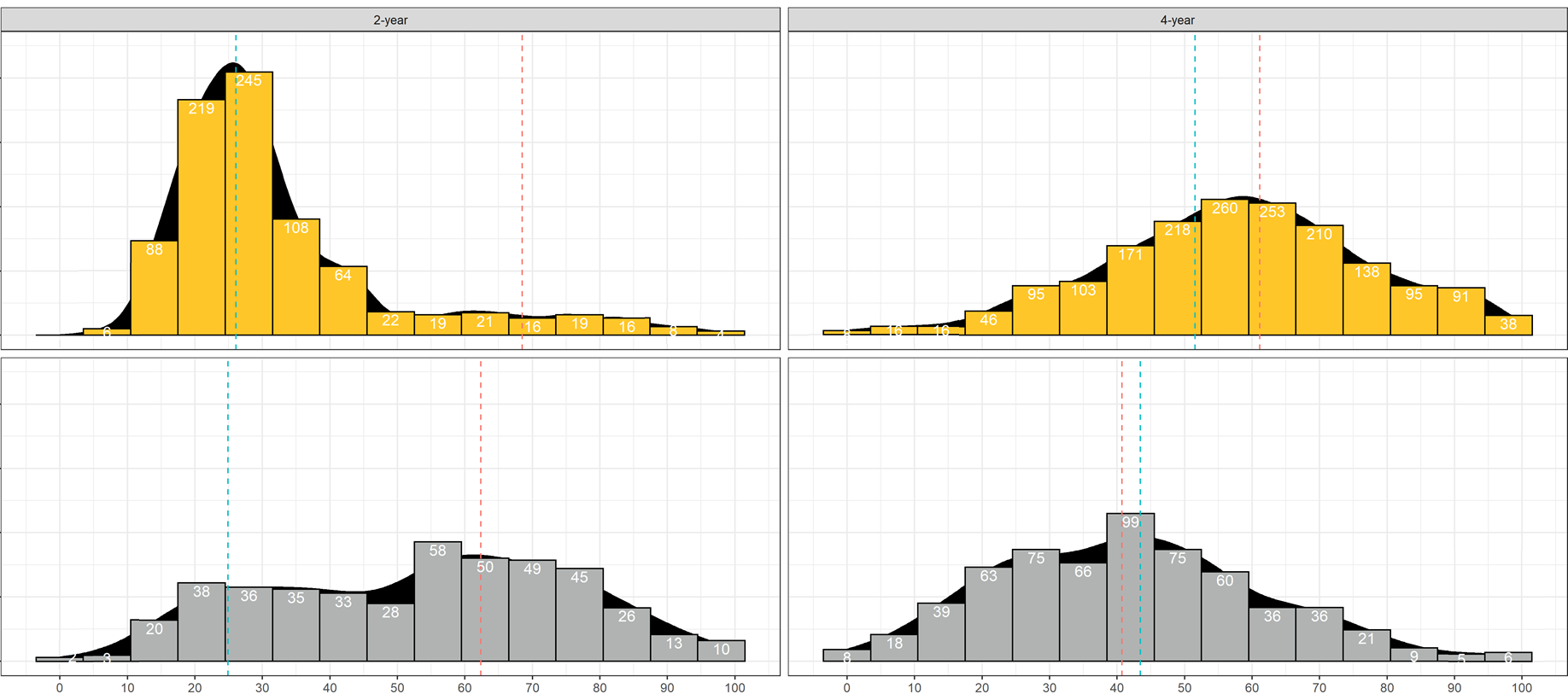

Slide 9
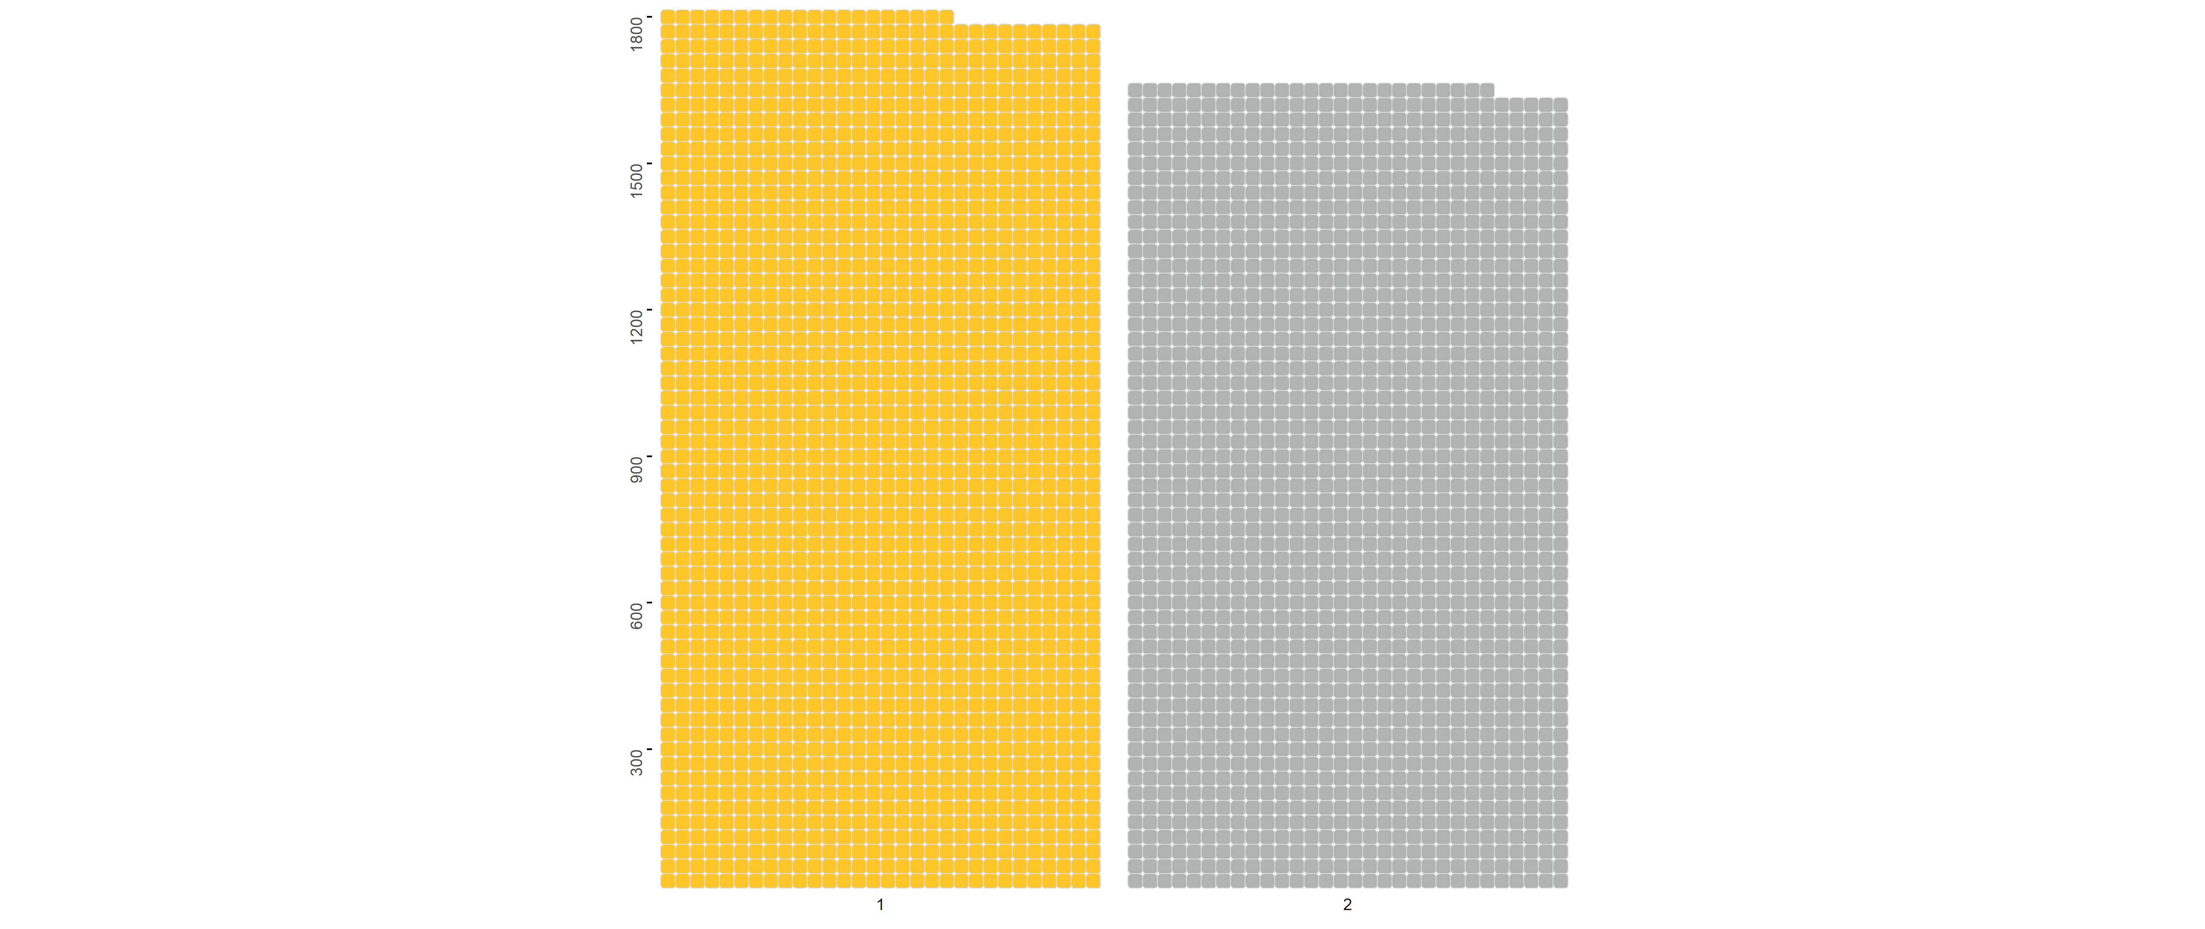
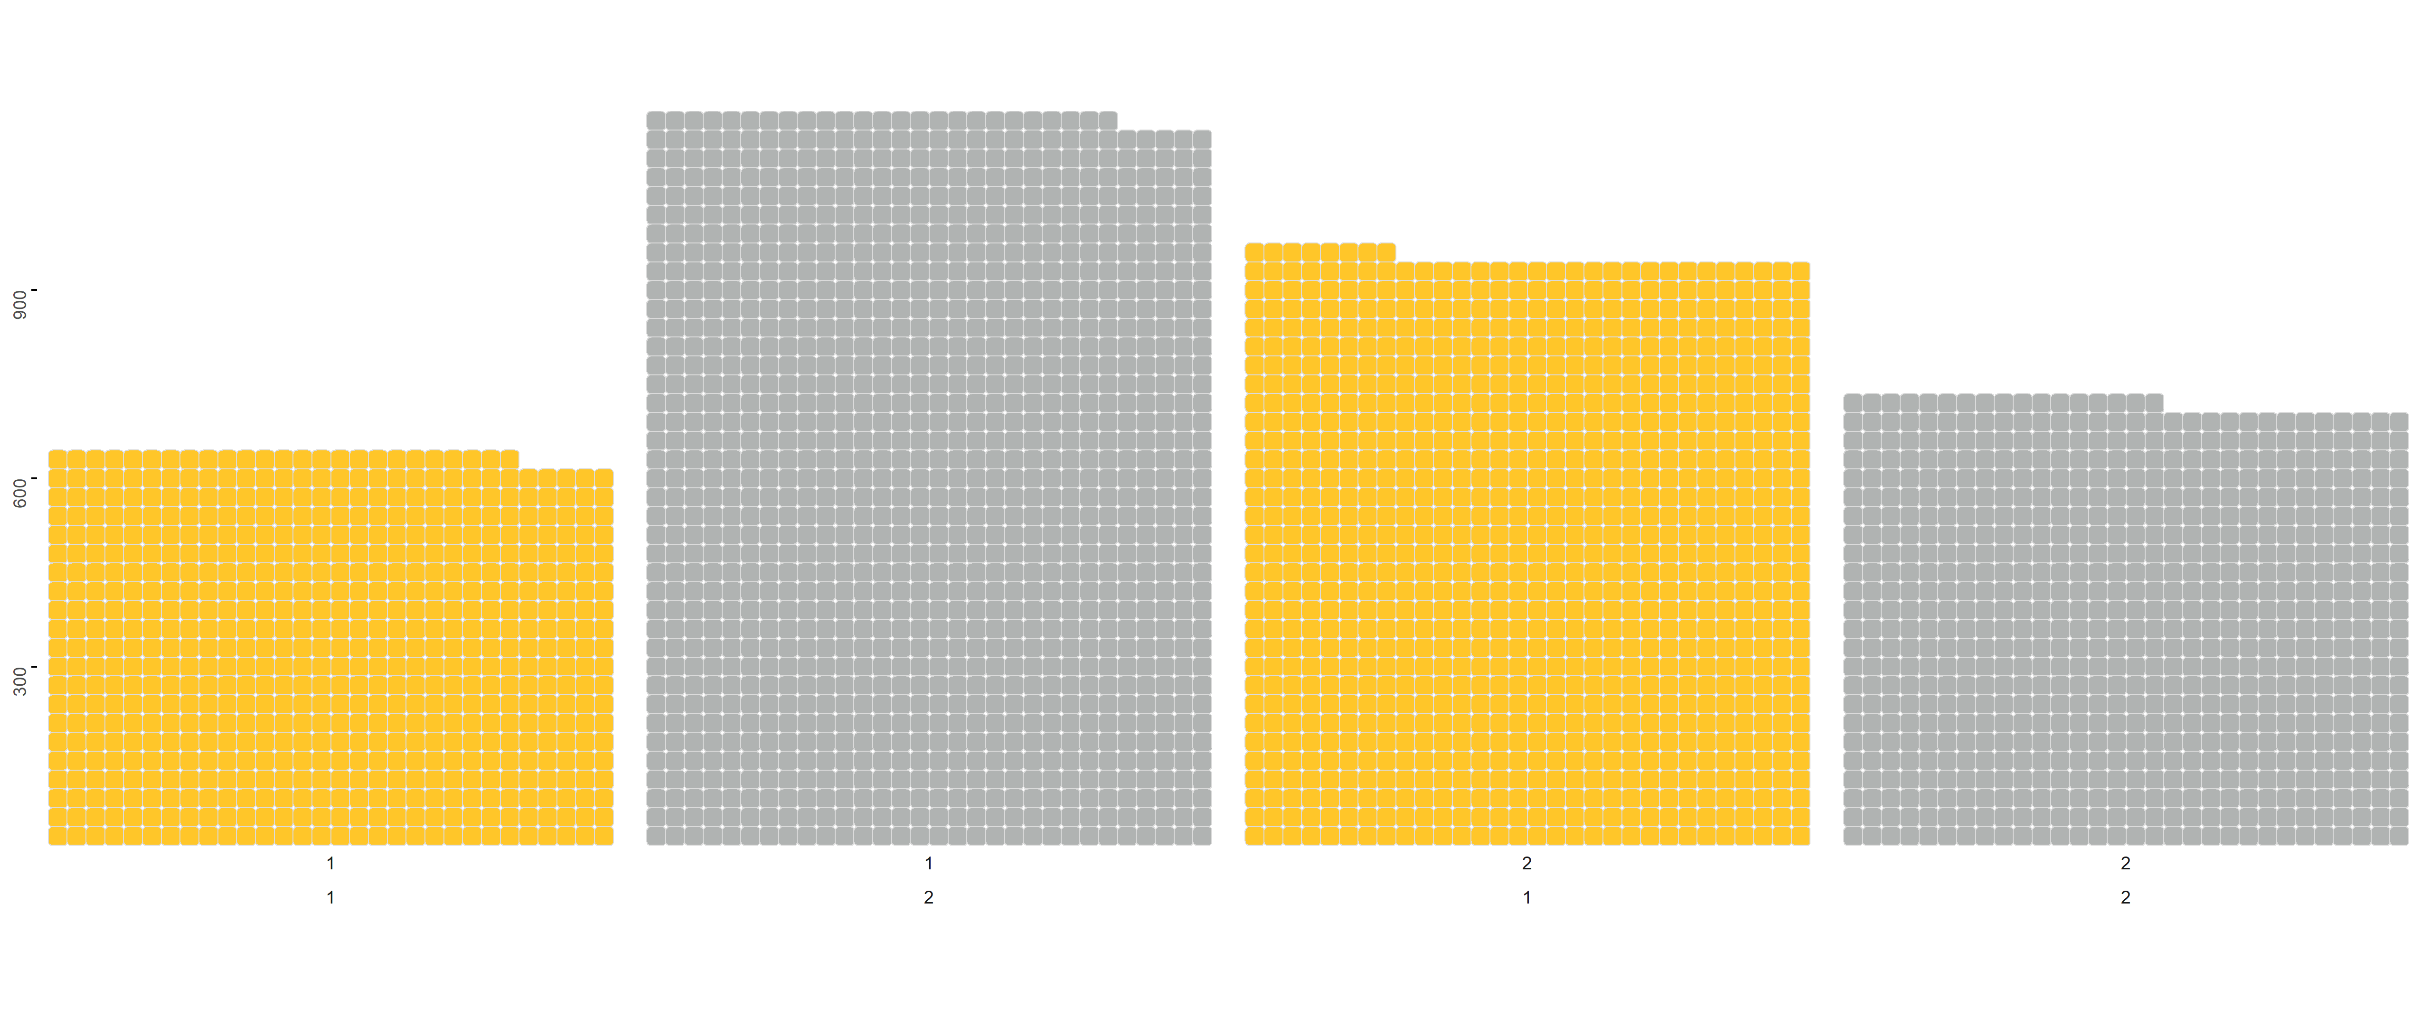
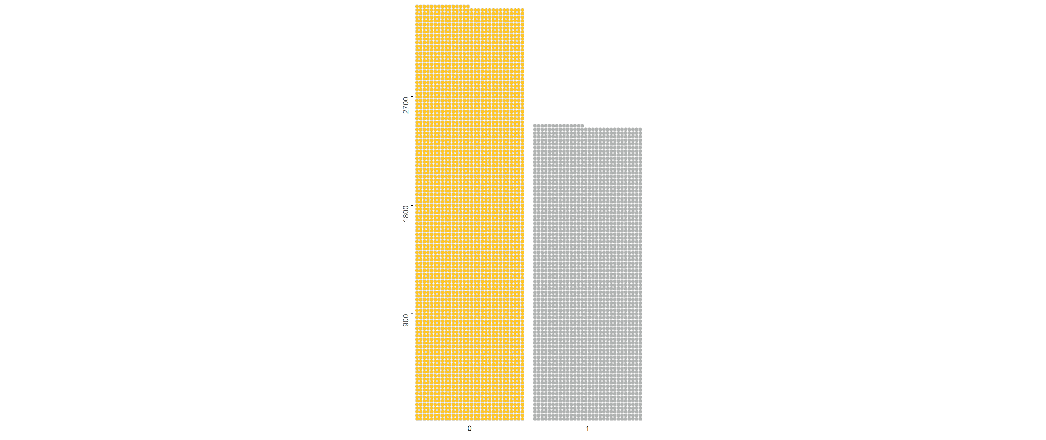
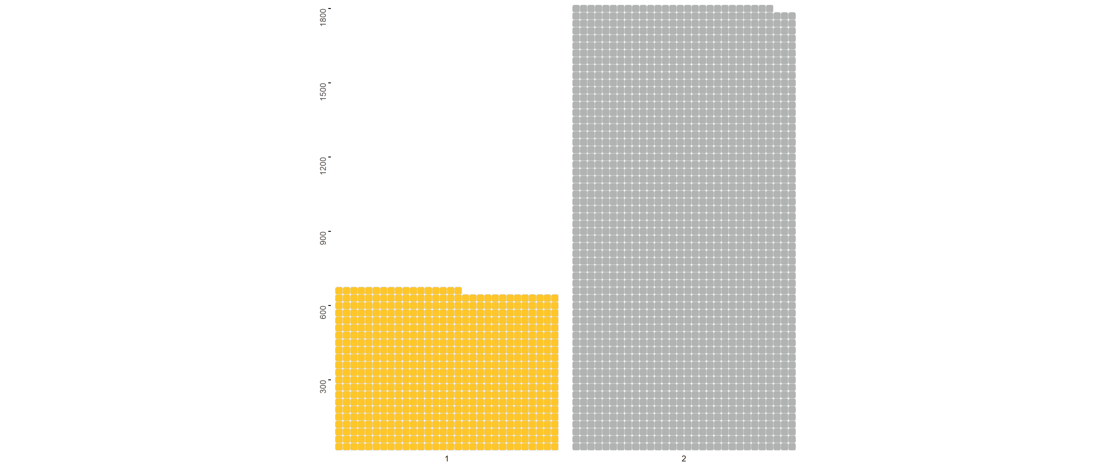
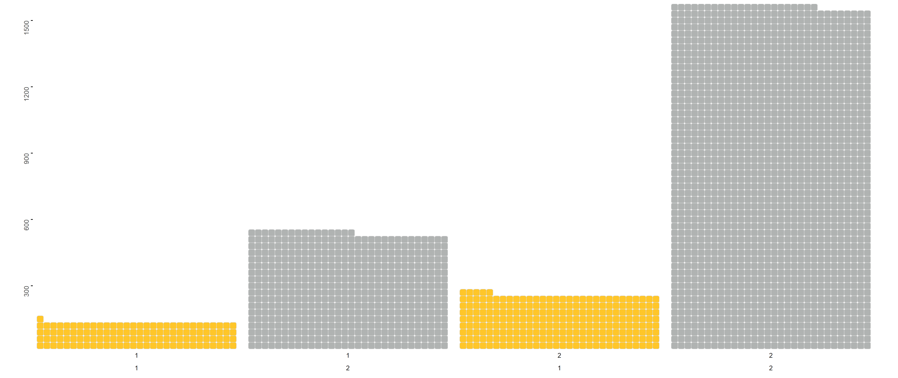
4-year (1)
vs
2-year (2)
Public (1)
vs
Private (2)
"#ffc629
Minority Pell:
Minority (0)
Vs
Majority (1)
One lighter
One darker
4 in total
Majority Pell:
Public (1)
vs
Private (2)
4-year (1)
vs
2-year (2)

Slide 10
4-year (1)
vs
2-year (2)
4-year (1)
vs
2-year (2)
Public (1)
vs
Private (2)
Public (1)
vs
Private (2)
Minority Pell:
Minority Pell:
Minority (0)
Vs
Majority (1)
Minority (0)
Vs
Majority (1)
Majority Pell:
Majority Pell:
Public (1)
vs
Private (2)
Public (1)
vs
Private (2)
4-year (1)
vs
2-year (2)
4-year (1)
vs
2-year (2)

Slide 11
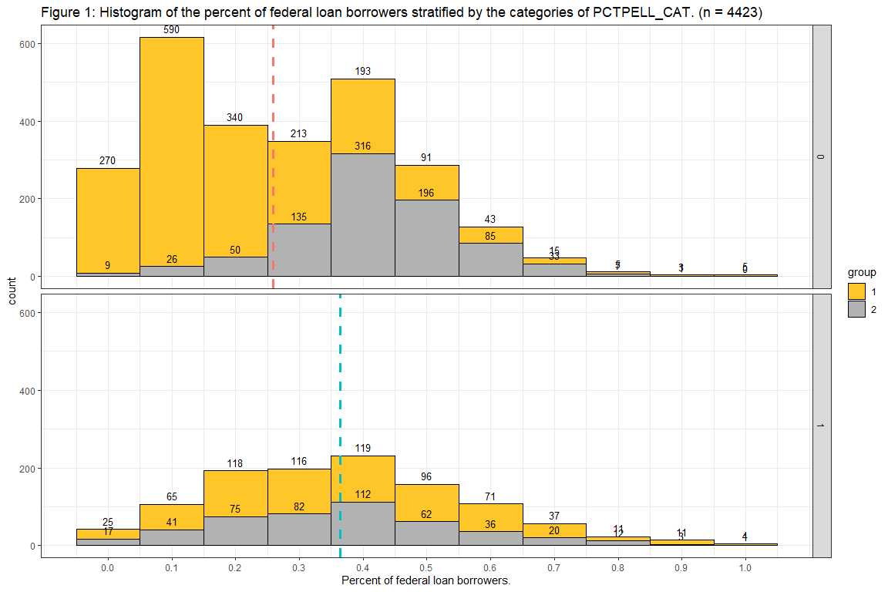
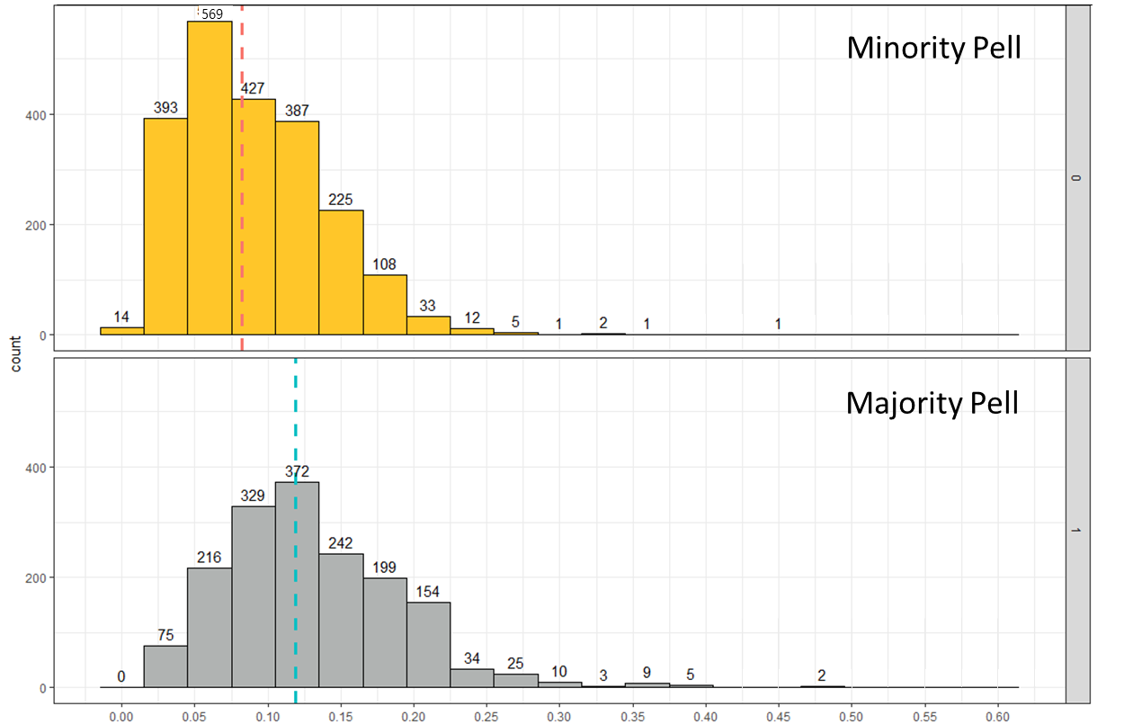

Pell Grant vs 2-year Default Rate
FINDING
The difference in the median percent of students that is in default at Majority Pell Institutions is 3.5% to 4.2% higher than Minority Pell Institutions.
TAKE-AWAY
Students receiving a Pell Grant attended universities with a higher 2-year loan default rate.
8%
12%
Percent of federal loan borrowers who entered default within 2 years
Notes:
We found that brookings was correct that majority Pell institutions have a higher default rate

Slide 12
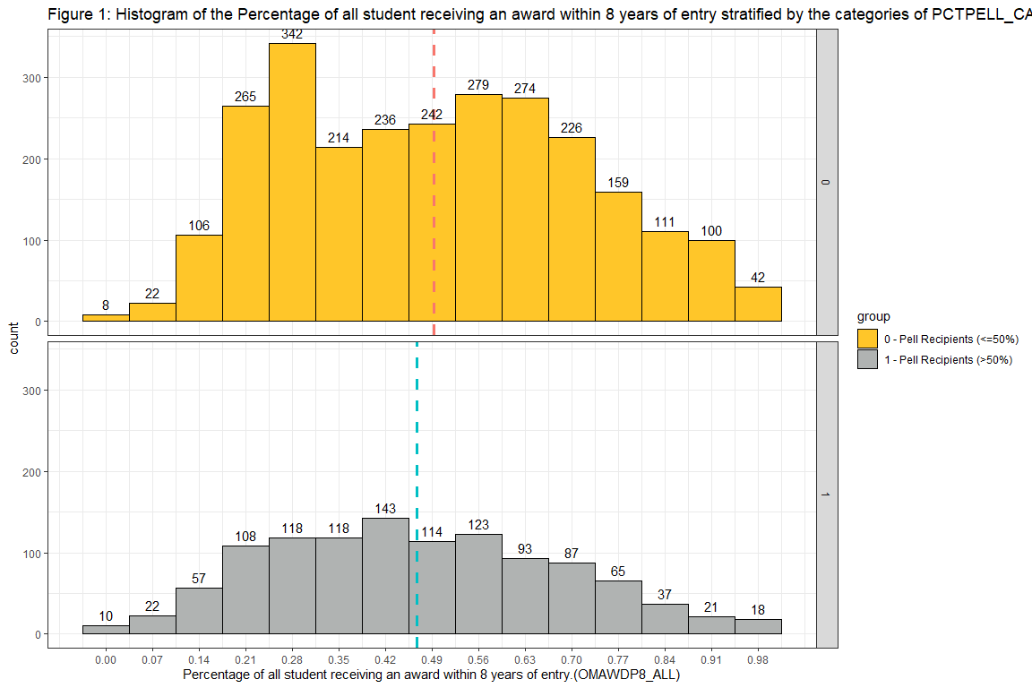
Pell Grant vs Graduation
Minority Pell
FINDING
The difference in the median percent of students that graduated at a Majority Pell Institutions is 1% to 4% lower than Minority Pell Institutions.
TAKE-AWAY
Students receiving a Pell Grant attended universities with lower graduation rates.
49%
Majority Pell
45%
Percent of Students that graduated within 8 years
Notes:
We found that brookings was correct that majority Pell institutions have a higher default rate

Slide 13
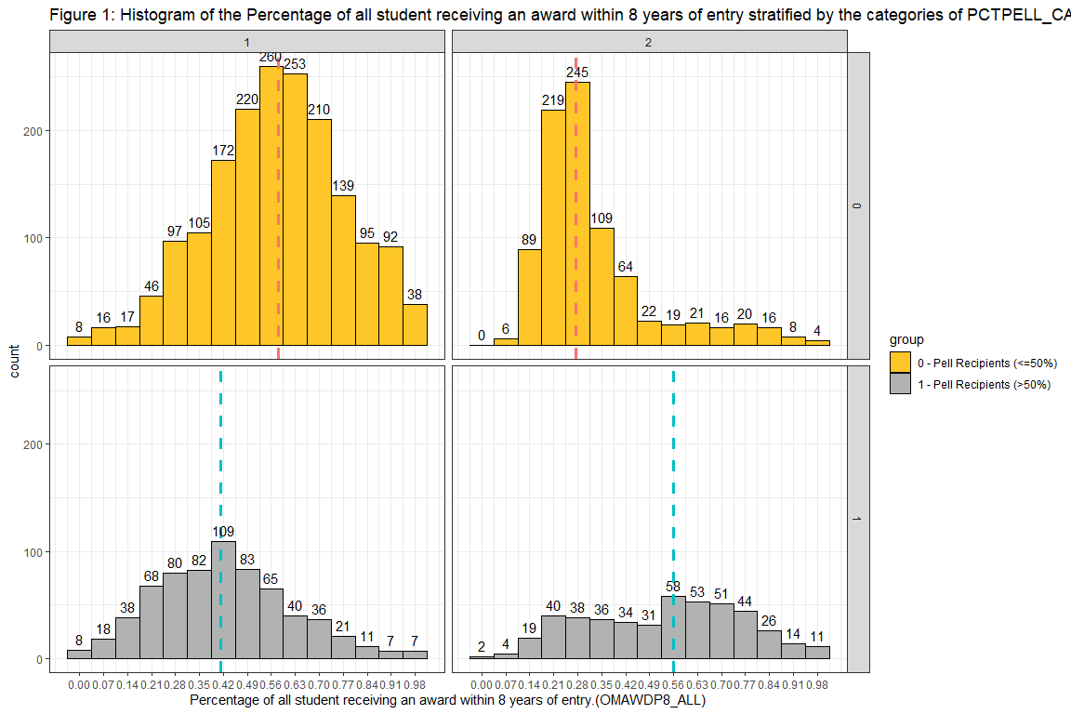
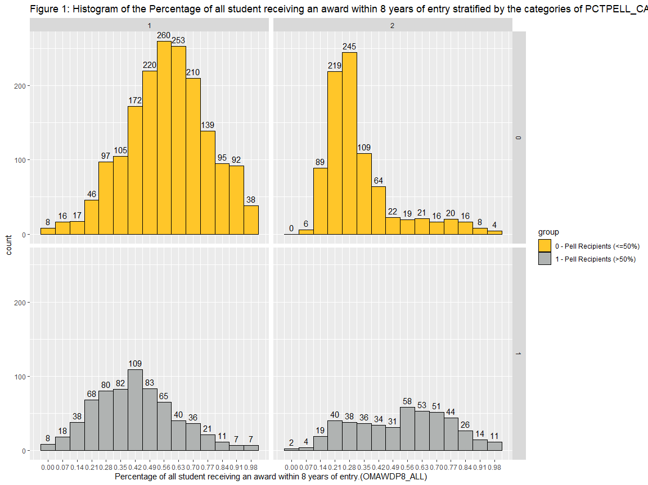
2-year
4-year
Pell Grant vs Graduation
Minority Pell
FINDING
4-year Graduation Rate
4-year Majority Pell schools have a 17% lower rate than 4-year Minority Pell schools.
2-year Graduation Rate
2-year Majority Pell schools have a 28% higher rate than 2-year Minority Pell schools.
Majority Pell—2-year Combination
Private 2-year Majority Pell schools have a graduation rate of 62%.
28%
58%
Majority Pell
Public 26%
Private 62%
56%
41%
Percent of Students that graduated within 8 years
Notes:
We found that brookings was correct that majority Pell institutions have a higher default rate
TAKE-AWAY
4-year minority Pell schools had a much higher graduation rate than 4-year majority Pell schools
2-year minority Pell schools acted similar to what we found during drop

Slide 14
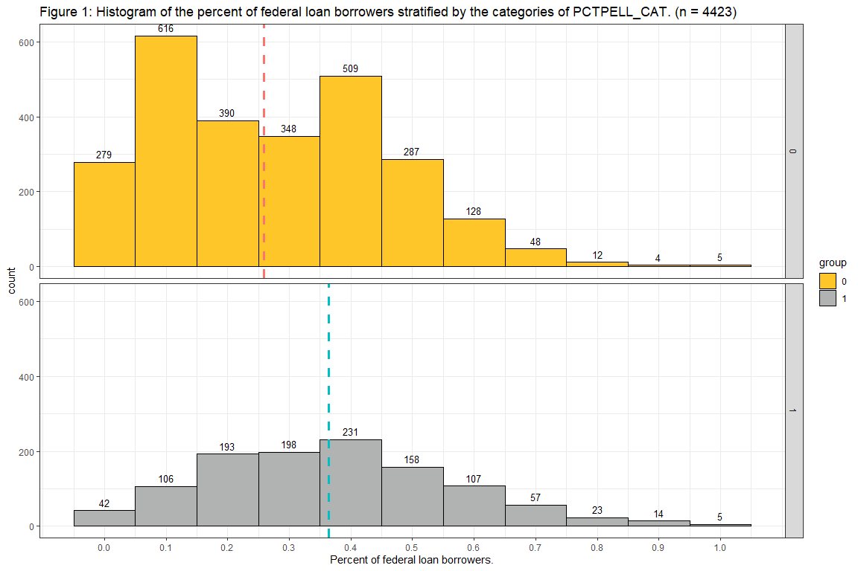
Pell Grant vs Dropout rate
FINDING
We are 95% confident that the median dropout rate for Majority Pell institutions is from 8 to 11% higher than Minority Pell institutions.
TAKE-AWAY
Majority Pell institutions have a higher dropout rate than Minority Pell institutions.
Minority Pell
26%
26%
Majority Pell
36%
Dropout rate
Notes:
This is confusing. facet apart the types
(4-facet)
GRAD VERSION
MAKE SURE SCRIPT GOES
Majority Pell
When we see two modes, we look for what categorical variable that would explain the two modes. (2-year/4-year)
If i was speaking to a 2-year institution I would be recomen the action item about educating their students about the pell grant.
Since I am talking to Kennesaw state, which is a 4-year inst, I would recommend that you are better off to have students not drop out already.
Action
-Less likely to drop out of school at a 4-year institution vs 2-year inst
-Maybe because 2-year inst have a low pell rate for the reason that their students do not know they are eligible for the Pell grant.

Slide 15
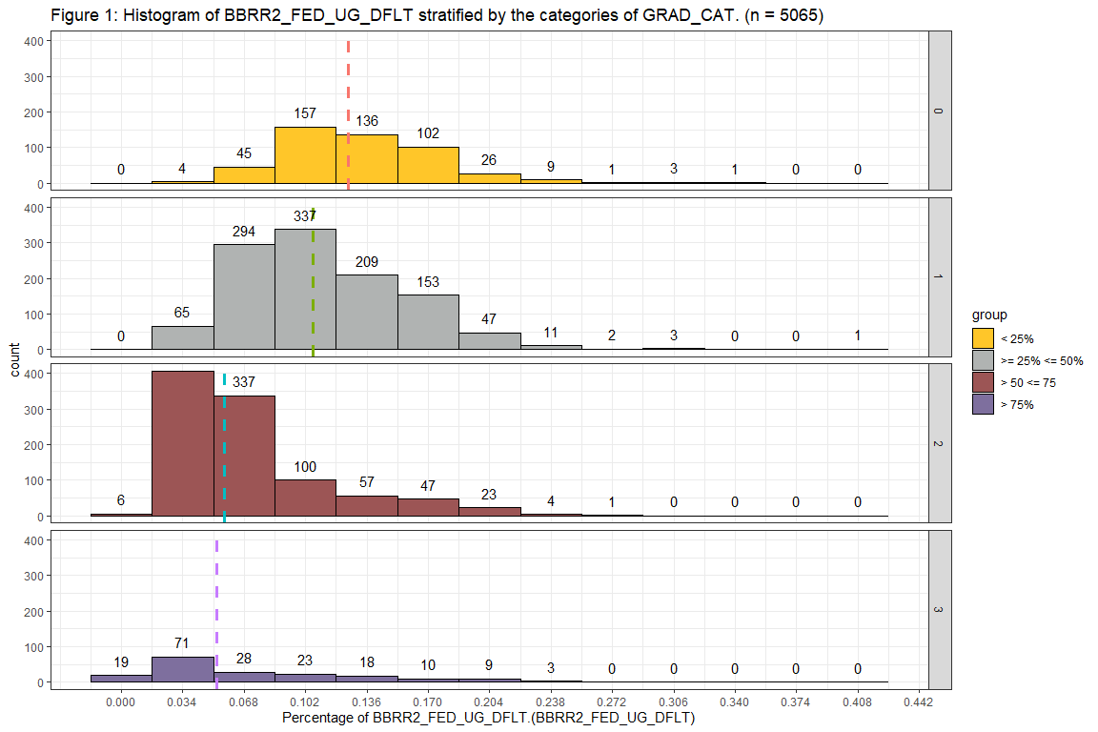
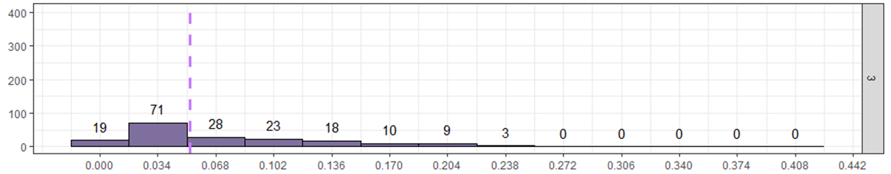
Graduation Rate vs Default Rate
< 25% students graduate within 8 years
12.56%
25% <= and <= 50% students graduate within 8 years
count
400
10.07%
50% < and <= 75% students graduate within 8 years
5.67%
> 75% students graduate within 8 years
5.28%
Percent of federal loan borrowers who entered default within 2 years
Notes:
USER FRIENDLY Hypothesis
Can remove ks logo
The question we are on turn colors.

Slide 16
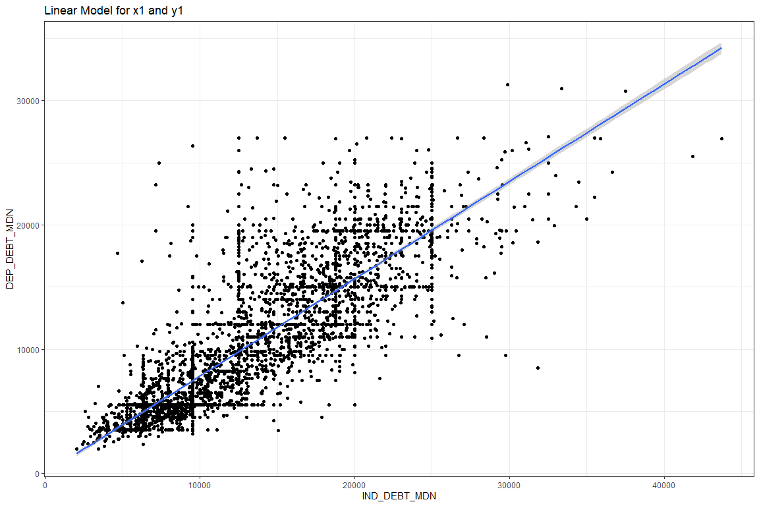
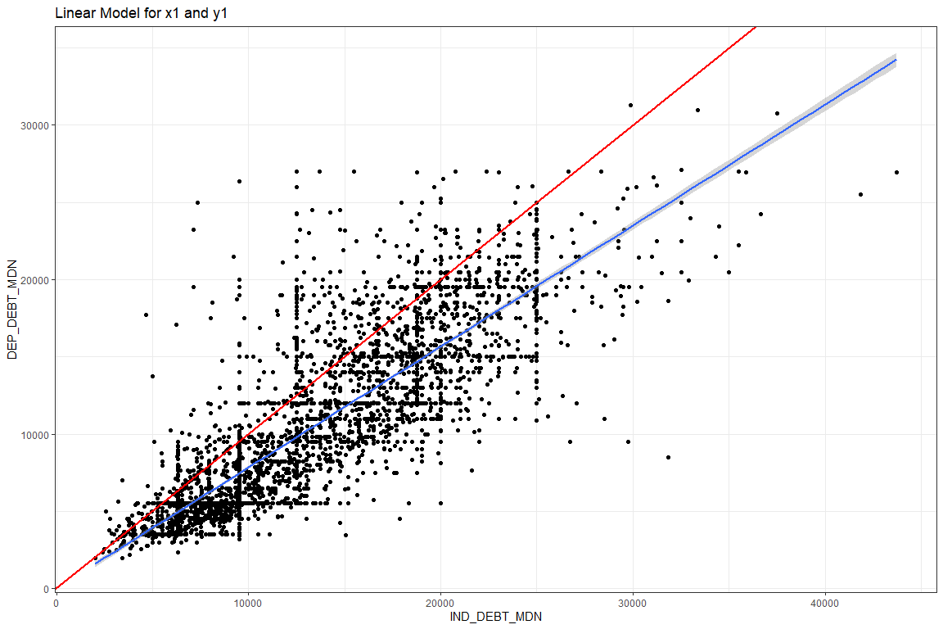
Independent vs Dependent
Independent = Dependent
Independent > Dependent
Independent > Dependent
Typical debt taken on by Dependent Students
Typical debt taken on by Independent Students
Notes:
SLIDE 1-7: measure success
SLIDE 8-n: goes with the drop the mic ending about dependent debt and plus loan debt.
INDY take out more because they have the eligibility.
Ind has more debt then dep
At this point I want to tell my story of
Dep students take less than independent.
Another part of this story that I will doing research on for the rest of the year as I present on other conference.
I will be looking at PLUS loan debt in combination to dependent and indepdent debt.
Even from this graphic, one can see that those who are dependent debt take out more than the independent counterparts.
One of the things I would counsel everyone here is to educate their friends and those in authority their students, the
Implication of being dependent. Their parents can take out PLUS debt which will limit the amount of money the student
Can take out.
My parents took thousands in PLUS loan debt that prevented me from
Poor family, qualified for full pell
These families can take PLUS loans that are supposed to be used for the student's academic progress.
But there is no legal check on the system to ensure these parents are utilizing this loan.
This caused me to not be able to afford medical cost, housing issues, and academic stress.
I was never counselled on the difference between dependent and independent.
Thus, this topic is very important to me, and I will be continuing to research
Thank you for coming. So that you can make a difference in peoples lives.
Thank you *specific ppl*
**I would like to recognize you
aethnography
Communicated with Student success services
Slept in ENO at K-Hall to show homelessness.
Continuelly talked about my situation with this depart.
Food that does not need to be cooked
X is bigger than y meaning the debt x is bigger than yx

